Slide 1

Quantitative Field Ecology Week 2
Summary Statistics!

Slide 2
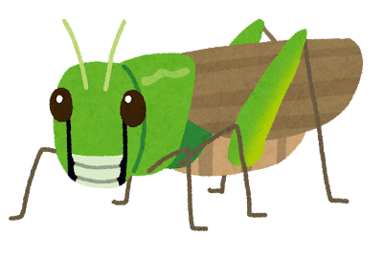
We have a set of data (i.e., lengths of grasshoppers from a field). How do we get to know it?
We perform some summary statistics on our sample! This is our first look at the data.
Notes:
ASK: can you think of any examples of summary statistics – we did some last week!

Slide 3
A caveat before we begin:
We have randomly sampled grasshoppers from a field and measured their length.
We sampled a subset of the population and will use statistics to infer unknown characteristics about the population from our sample.
We estimate the truth based on the sample!
Notes:
ASK: In this case, what is the population in question?

Slide 4
Parameters and Statistics
Parameter = a true value describing a population (e.g., means, proportions, correlations)
Populations have parameters
Estimate, statistic = values that we calculate from a sample of the population
Samples have estimates and statistics

Slide 5
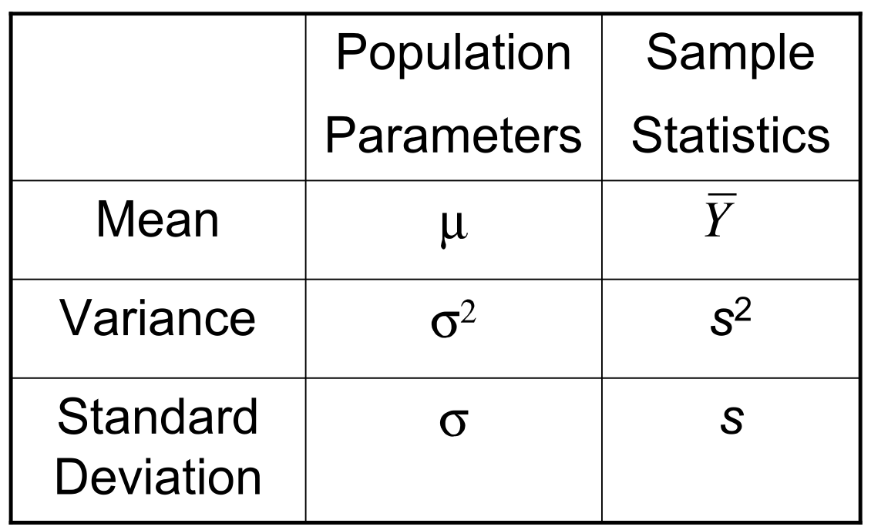
These have different symbols!
Notes:
So if you’re looking at a formula, etc., you know if it’s a population or sample mean, etc. based on the symbol used
ASK: If we wanted to get the population mean of the grasshoppers in the field what would we have to do? And is that realistic?

Slide 6

We will do our summary statistics based on our sample, looking at location and spread:
We measured the lengths of 10 grasshoppers (cm): 3.42, 6.17, 1.85, 5.09, 2.63, 4.91, 7.00, 1.28, 6.54, 3.76
Location: where majority of data are found
  Mean, median & mode
Spread: how variable the data are
  Standard deviation, variance, standard errors
Notes:
3.42, 6.17, 1.85, 5.09, 2.63, 4.91, 7.00, 1.28, 6.54, 3.76

Slide 7
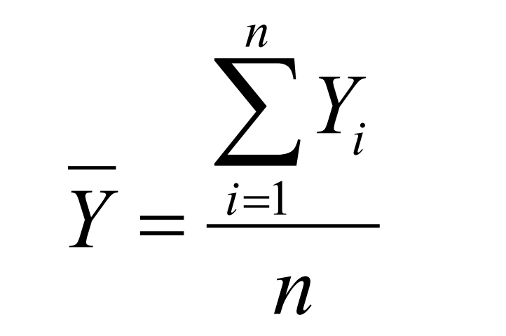
Location: Arithmetic Mean
Unbiased estimator of μ
Assumptions:
  Randomly selected individuals
  Observations are independent
  Observations made on data drawn from a larger population hat is normally distributed
Based on Law of Large Numbers:
  Estimate approaches μ as sample size gets larger
Notes:
The formula looks crazy. Big E means sum, so all I do is sum up all of the observations, and divide it by the number of observations

Slide 8
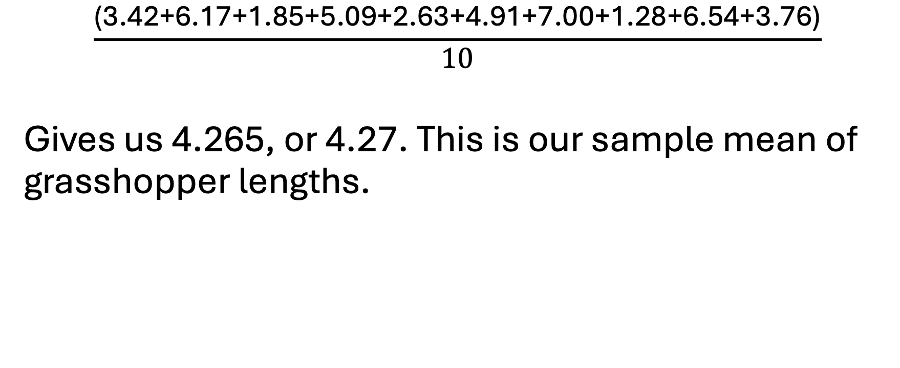
Example:
$$\frac{\text{(}\text{3.42}\text{+}\text{6.17}\text{+}\text{1.85}\text{+}\text{5.09}\text{+}\text{2.63}\text{+}\text{4.91}\text{+}\text{7.00}\text{+}\text{1.28}\text{+}\text{6.54}\text{+}\text{3.76}\text{)}}{10}$$
Gives us 4.265, or 4.27. This is our sample mean of grasshopper lengths.

Slide 9
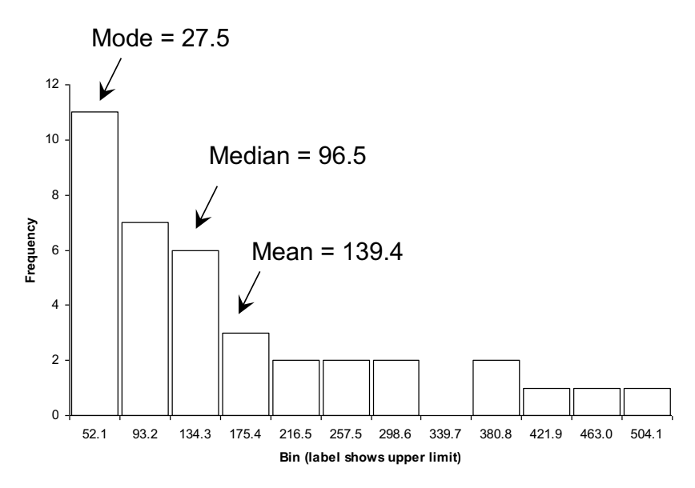
Location: Median
Median: value in a set of ordered observations that has 50% of the observations above and below it
1.28, 1.85, 2.63, 3.42, 3.76, 4.91, 5.09, 6.17, 6.54, 7.
  In our case, it’s between 3.76 and 4.91, so we average these two to get 4.335, or 4.34.
Notes:
If there’s a larger number of observations… just use a computer program like JASP because phew

Slide 10
Location: Mode
Mode: value that occurs most frequently
Easy to ID for discrete data
Highest bar on histogram for continuous data
  (The mode is the interval corresponding to the highest peak.)

Slide 11
Spread: IQR
Quartiles: values that partition the data into quarters.
The first quartile is the middle value of the measurements lying below the median. The second quartile is the median. The third quartile is the middle value of the measurements larger than the median.
The interquartile range (IQR) is the span of the middle half of the data, from the first quartile to the third quartile: IQR=Q3-Q1
  If the median is the middle (50%), what is the first quartile? The third?
Notes:
Q1 represents 25% and Q3 represents 75%

Slide 12
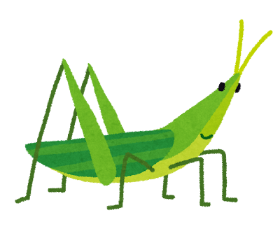
Example:
1.28, 1.85, 2.63, 3.42, 3.76, 4.91, 5.09, 6.17, 6.54, 7.
Median of bottom half (Q1)and top half (Q3) of data (we already know the median – between 3.76 and 4.91
  Q1 = 2.63
  Q3 = 6.17
Q3-Q1
  6.17- 2.63 = 3.54
Notes:
If you use JASP or R to calculate this, it will be different because they use a fancy algorithm, unless you specify for it not to and then it will match. Don’t worry about it

Slide 13
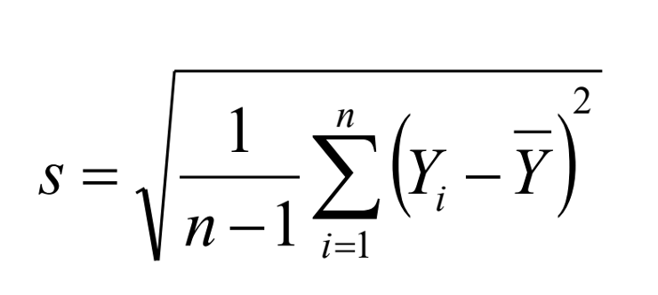
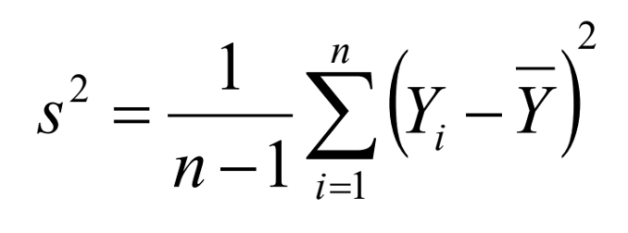
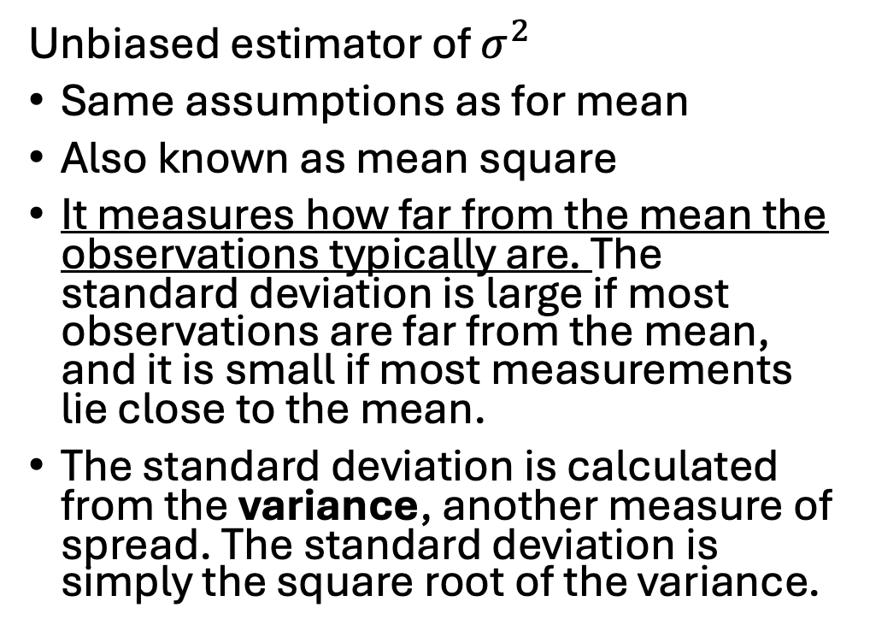
Spread: Variance and Standard Deviation
Unbiased estimator of $σ^{2}$
Same assumptions as for mean
Also known as mean square
It measures how far from the mean the observations typically are. The standard deviation is large if most observations are far from the mean, and it is small if most measurements lie close to the mean.
The standard deviation is calculated from the variance, another measure of spread. The standard deviation is simply the square root of the variance.
Notes:
Now why might we use standard deviation over variance? You hear a lot of st.dev. This st.dev. That – imagine our grasshopper lengths. Measured in centimeters.
ASK: What would the units be on the variance? Squared. What would they be on the st.dev.? Just centimeters.
Standard deviation is more intuitive to use because it has the same units as the variable itself, but sometimes the variance is useful.

Slide 14
Spread: Variance and Standard Deviation
Calculating: compute deviations (difference between measurement and the mean)
We square the deviations so deviations above and below the mean can contribute equally to the variance
Divide by n-1; gives a more accurate estimate of the population variance
Notes:
Square things because otherwise we would have some negative numbers

Slide 15
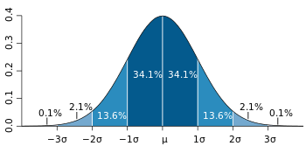
Spread: Variance and Standard Deviation
If the frequency distribution is bell shaped then about two-thirds of the observations will lie within one standard deviation of the mean, and about 95% will lie within two standard deviations.
In other words, about 67% of the data will fall between Y-s and Y+s, and about 95% will fall between Y-2s and Y+2s.

Slide 16
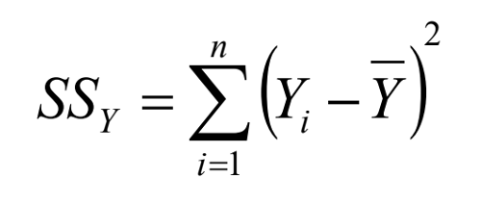

Sum of Squares, Degrees of Freedom
SSY: sum of squares
Integral to numerous other procedures
Degrees of Freedom: n-1
Number of independent pieces of information we have to estimate the parameter
We lose 1 because we use up 1 for using the sample mean
Notes:
ASK: Do you recognize the formula for the sum of squares? It’s the first part of the St.dev formula!

Slide 17
Spread: Standard Error
The standard deviation of the sampling distribution of an estimate
Reflects the differences between an estimate and the target parameter; it reflects the precision of an estimate
Estimates with smaller standard errors are more precise than those with larger standard errors. The smaller the standard error, the less uncertainty there is about the target parameter in the population.
Decreases with increasing sample size

Slide 18
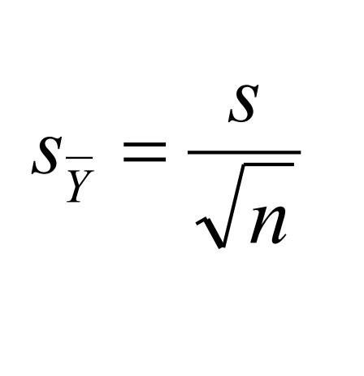
Spread: Standard Error of the Mean
Describes the variance in the sample mean, study to study
Sample standard deviation divided by the square-root of n (# of samples)
Generally the error bars when you see a plot in a journal article
Notes:
How much would the sample mean bounce around if you were to take a ton of samples from the same population?

Slide 19
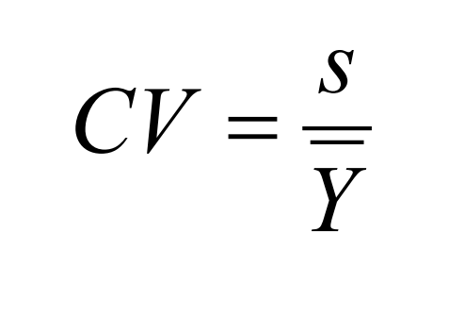
Spread: Coefficient of Variation
Unitless
Calculates the standard deviation as a percentage of the mean
A higher CV means that there is more variability, whereas a lower CV means that individuals are more consistently the same, relative to the mean
Allows variance to be compared among studies
Notes:
Why is this important? “What is more variable in elephants, body mass or life span?” are measurements typically farther from the mean for an elephants body mass or their life span? We can’t compare these directly.
ASK: what is body mass measured in? what is life span measured in?
Different units, then the standard deviation is not very informative, because mass is measured in kilograms and life span is measured in years.
If we divide units by units, then The coefficient of variation would allow us to make this comparison.

Slide 20
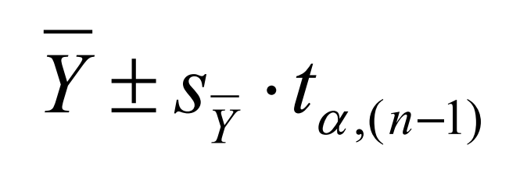
Confidence Interval
Range of values surrounding the sample estimate that is likely to contain the population parameter.
Describes how confident we are that our interval covers the true population parameter we are interested in (generally μ)
95%, 90% most common
Interpretation of CI (4, 6)
  “I am 95% confident that the interval (4,6) covers the true population mean.”
  NOT “95% chance the population mean is in the interval (4,6).”

Slide 21
Confidence Intervals Explained
20 researchers independently take unique random samples of n=100 genes
Each researcher calculates an estimate Y and then a 95% confidence interval for the parameter (the population mean, μ ). Each researcher ends up with a different estimate and a different 95% confidence interval, because by chance their samples are not the same.
On average, however, 19 out of 20 (95%) of the researchers’ intervals will contain the value of the population parameter. On average, therefore, 1 out of 20 intervals (5%) will not contain the parameter value. None of the researchers will know for sure whether his or her own confidence interval contains the value of the unknown parameter, but each can be “95% confident” that it does.

Slide 22
Confidence Intervals Explained
All numbers falling between the lower and upper bounds of a confidence interval can be regarded as the most plausible values for the parameter, given the data sampled. Values falling outside the confidence interval are less plausible.
If the confidence interval is broad, then uncertainty is high and the data are not very informative about the location of the population parameter. If the confidence interval is narrow, on the other hand, then we can be confident that the parameter is close to the estimated value.

Slide 23
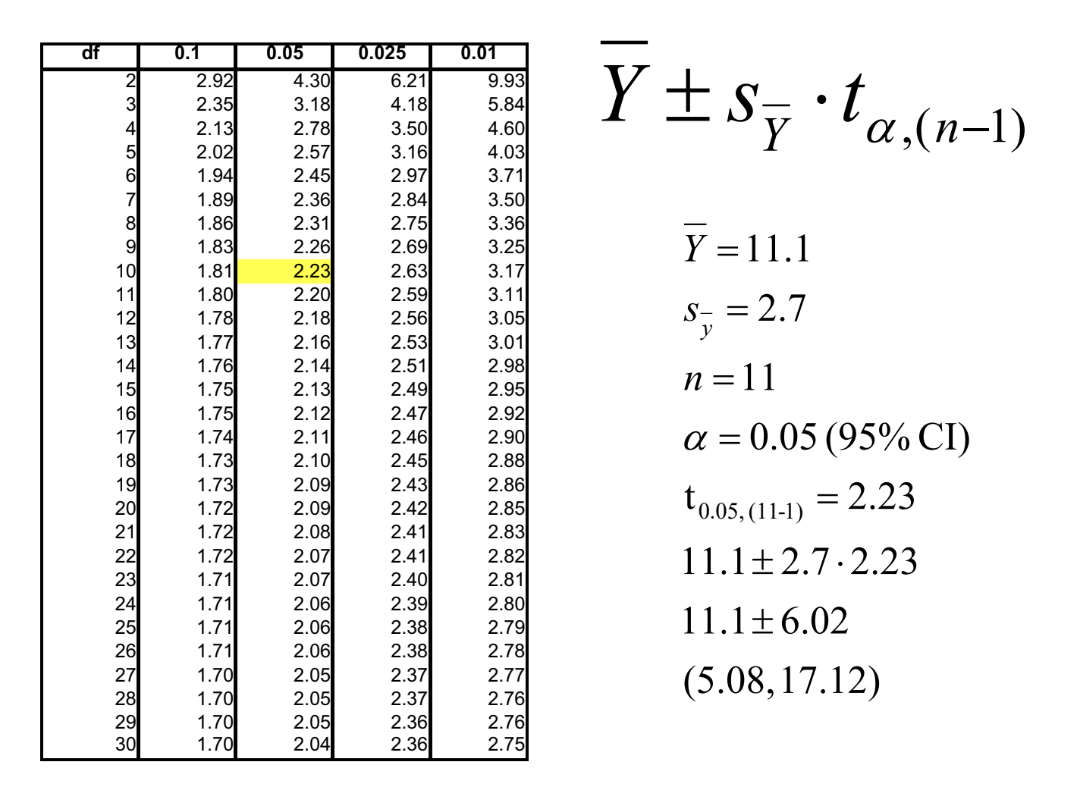

What is t?
Notes:
T is the critical value!
I want a 95% confidence interval. My alpha is 0.05 (5%)
You have your sample size, and then you can get the degrees of freedom by just subtracting 1 from that
Then use the table – column of your interval size, and row of your DF gives you your critical value.
Follow through on the math, and you have the confidence interval here.
ASK: interpret the confidence interval! I am 95% confident that the interval (5.08 to 17.12) covers the true population mean

Slide 24
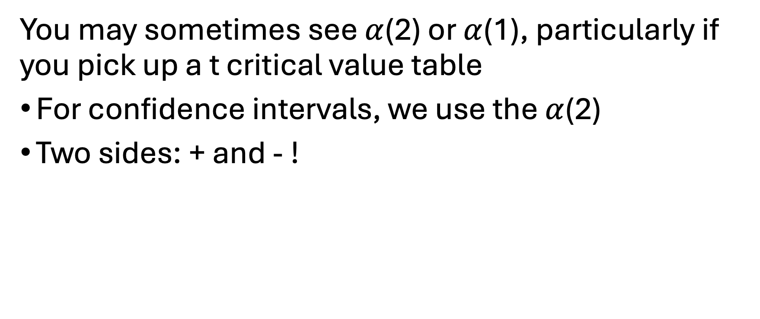
Two vs. One
You may sometimes see $α$(2) or $α$(1), particularly if you pick up a t critical value table
For confidence intervals, we use the $α$(2)
Two sides: + and - !

Slide 25
Confidence Interval Hint:
A rough approximation to the 95% confidence interval for a mean can be calculated as the sample mean plus and minus two standard errors.
For work you turn in, use the real formula (or get a computer program to help you)!

Slide 26

Lecture Activity: Grasshopper Lengths
Try it yourself!
Open the lecture activity document in Blackboard and get started!
It’s fairly short, but you will have class time on Thursday to work on this if you need to as well!
Due on Sunday Sept. 6 at 11:59 PM

